Slide 1
Getting Started to Quartus II Software
Chapter3

Slide 2
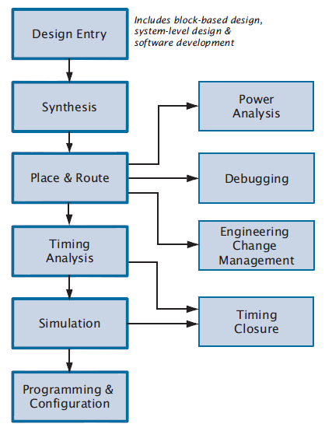
Quartus II Design Flow
The Altera Quartus II design software provides a complete, multiplatform design environment that easily adapts to your specific design needs. It’s a comprehensive environment for System-On-Programmable-Chip (SOPC) design.
Figure 1: Quartus II Design Flow

Slide 3
Quartus II Design Flow
Design Entry
The design file (.hdl) which consist of design behavioral.
Synthesis
To analyze and synthesis the design file (.hdl) and then generate an EDIF netlist file (.edf). (syntax error check )
Place & Route
Determines the placement of the LEs defined in the netlist into the LEs in an actual FPGA chip. Only emphasized when program design onto Altera chip.
Timing Analysis
Used to analyze timing performance of the design. Only emphasized when program design onto Altera chip.

Slide 4
Quartus II Design Flow
Simulation
Will used simulation tool to tested and verify both its functional correctness and timing. Example of supported simulation tool is Mentor Graphics ModelSim-Altera.
Programming & Configuration
Used the Quartus II Programmer to program the design and configure device.

Slide 5
Quartus II Graphical User Interface Design
Quartus II offers easy design entry (using schematics, block diagram, AHDL, VHDL and Verilog), powerful logic synthesis, functional and timing simulation, device programming and verification by using Quartus II GUI Design.
The default Quartus II software GUI can be divided into six main components:
Drop-down Menus – provide access to all features of Quartus II software.
Adjustable Toolbar – shortcut to most frequently used tools.
Project Navigation Window – Control project option & source files.
Status Window – provide status information on any process in progress.
Editor Window – Source files review and editing .
Console Window – Display design flow related messages.

Slide 6
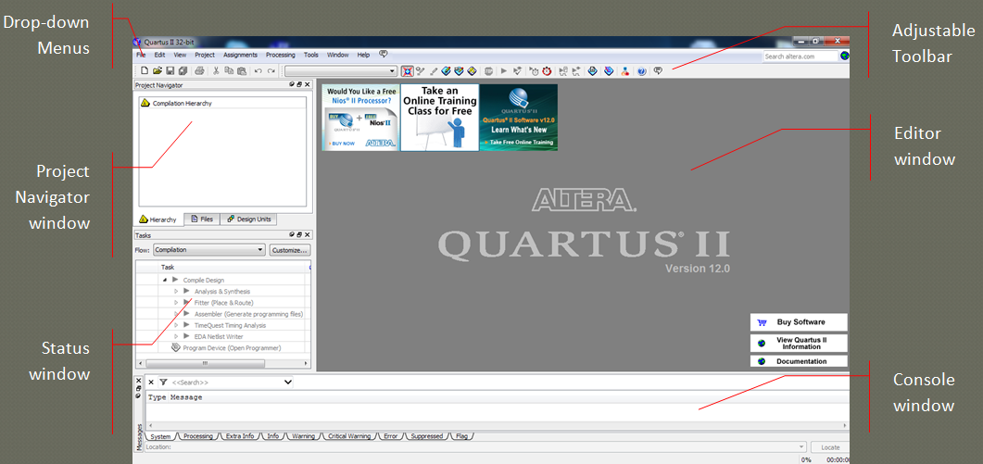
Quartus II Graphical User Interface Design
Figure 2: Quartus II Graphical User Interface

Slide 7
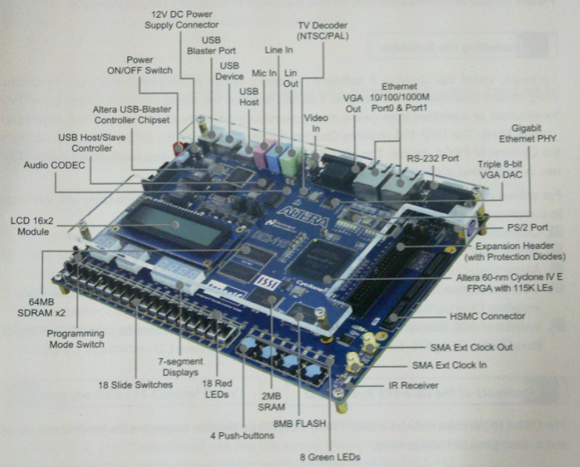
DE2-115 Altera Development & Education Board

Slide 8
VHDL Term
Entity
Architecture
Configuration
Package
Driver
Bus
Attribute
Generic
Process

Slide 9
Entity
An entity is the most basic building block in a design. In hierarchical design, the top-level entity description will have lower-level descriptions contained in it.
Architecture
An architecture describes the behavior of the entity. A single entity can have multiple architectures.
Configuration
A configuration statement is used to bind a component instance to an entity-architecture pair.

Slide 10
Package
A package is a collection of subprograms used in a design. This package can be assume as a toolbox that contains tools used to build designs.
Driver
Driver is a source on a signal, for example, If a signal is driven by two sources, then when both sources are active, the signal will have two drivers.
Bus
a bus is a special kind of signal that may have its drivers turned off.

Slide 11
Attributes
An attribute is data that are attached to VHDL objects or predefined data about VHDL objects.
Generic
A generic is VHDL’s term for a parameter that passes information to an entity.
Process
A process is the basic unit of execution in VHDL. All operations that are performed in a simulation of a VHDL description are broken into single or multiple processes.

Slide 12
Entity
Entity
An entity is the most basic building block in a design. In hierarchical design, the top-level entity description will have lower-level descriptions contained in it. Example of OR entity:
ENTITY or IS
PORT ( x1, x2 : IN STD_LOGIC ;
f : OUT STD_LOGIC ) ;
END or;

Slide 13
Architecture
One or more implementations of the entity can be described in architecture bodies.
Each architecture body can describe a different view of the entity.
For example, one architecture body may purely describe the behavior, whereas others may describe the structure of the entity as a hierarchically composed collection of components.

Slide 14
Architecture (Cont.)
Architecture
An architecture describes the behavior of the entity. A single entity can have multiple architectures.
The Architecture describes the underlying functionality of the entity and contains the behavioral statement .
ARCHITECTURE LogicFunction OF orIS
BEGIN
f <= (x1) OR (x2);
END LogicFunction ;

Slide 15
Architecture Declarations
An architecture body is declared using the syntax:
Architecture_body ::= architecture identifier of entity_name is architecture_declarative_part begin architecture_statement_part end [ architecture_simple_name ] ;
Architecture_declarative_part ::= { block_declarative_item }
Architecture_statement_part ::= { concurrent_statement }
Block_declarative_item ::= subprogram_declaration | subprogram_body | type_declaration | subtype_declaration | constant_declaration | signal_declaration | alias_declaration | component_declaration | configuration_specification | use_clause
Concurrent_statement ::= block_statement | component_instantiation_statement

Slide 16
Structure
Structure
The structure of the design is start with ENTITY and follow by ARCHITECTURE.
LIBRARY ieee ;
USE ieee.std_logic_1164.all ;
ENTITY adder IS
PORT ( x1, x2 : IN STD_LOGIC ;
f : OUT STD_LOGIC ) ;
END adder;
ARCHITECTURE LogicFunction OF adder IS
BEGIN
f <= (x1) OR (x2);
END LogicFunction ;

Slide 17
Behavioral
Behavioral
The behavioral statement is describe the functionality of the design.
ARCHITECTURE LogicFunction OF adder IS
BEGIN
f <= (x1) OR (x2);
END LogicFunction ;

Slide 18
How To Start Design?
Steps to design and implement a circuit using the VHDL hardware description language as follows:-
Create a New Project
Design entry
Design Compilation
Design Simulation
Place & Route and Timing Analysis
Pins Assignment
Programming and Configuration
- Go to Getting Started tutorial for warm up session..

